Slide 1
Household Intake in CMS
MOC Inc

Slide 2
Agenda
Household Intake Introduction
System Summarized Data
Manually Entered Data

Slide 3
Household Intake Introduction

Slide 4
Household Intake Introduction
The Household Intake Module provides the ability to capture key household characteristics such as household size and annual income, without entering each household member as separate client records within the system.
The Module will not prevent you from entering individual Client Financial information but provides a quicker way to enter total household information quickly in one page without going to each individual Household Record.

Slide 5
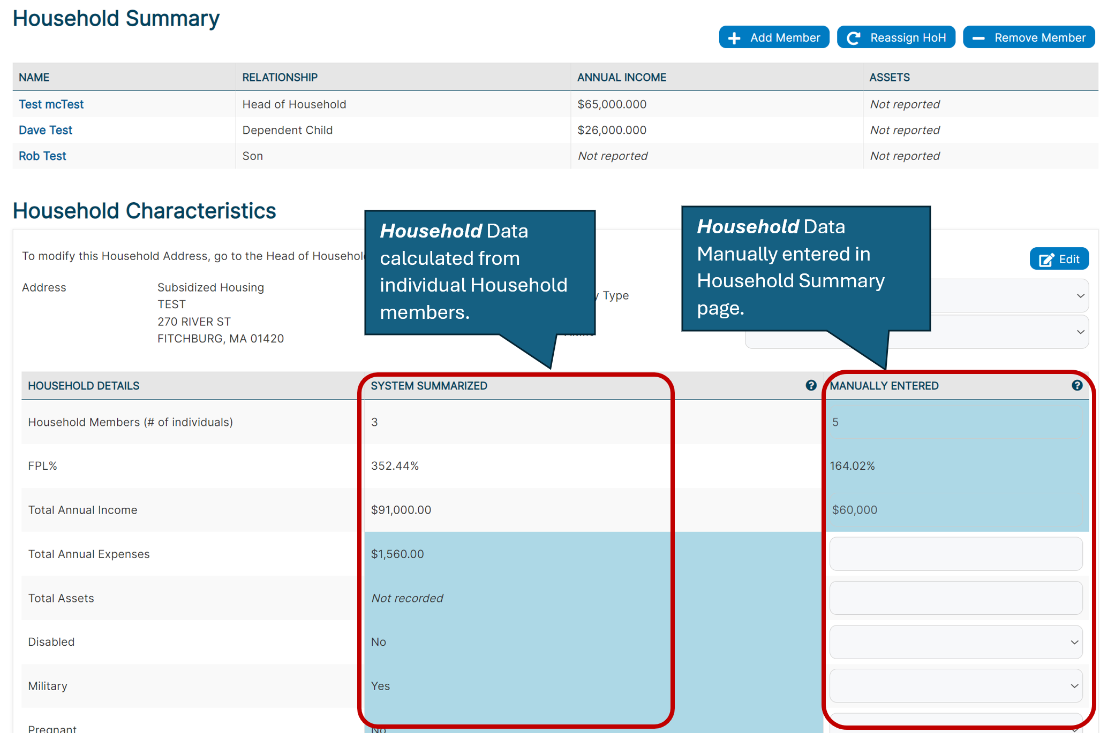
New Household Summary Screen

Slide 6
System Summarized Data

Slide 7
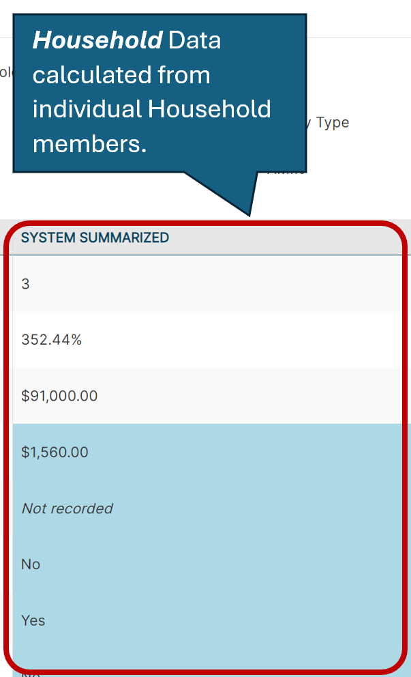
Household Intake Screen – System Summarized Data

Slide 8
Household Intake Screen – System Summarized Data
System Summarized Data - This column summarizes Household Details for all individual clients added to the household record.
Household summarized data as you are currently used to seeing it in the Household Summary page in CMS.
Individual client records and client data must be inputted for the System Summarized column to reflect correct values.
To update these values, the user must go to the client record they wish to add information to. This column will be updated as there are changes to data in household member individual records or when household composition changes (add or removal of household member).
If any single household members’ data reflects a “Yes” value for Disabled, Military, Pregnant, or Under 21 metrics, this column will show “Yes.”

Slide 9
Manually Entered Data

Slide 10
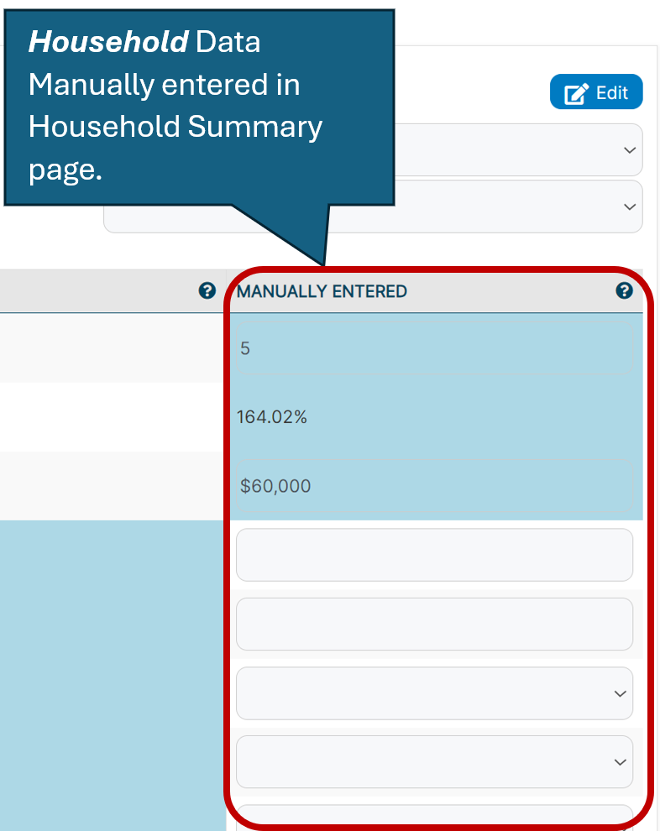
Household Intake Screen – Manually Entered Data

Slide 11
Household Intake Screen – Manually Entered Data
Manually Entered Data – This column is intended to be used when a user is not entering in individual client records to the CMS and needs to add quick information about a household.
In the Household Summary page data highlighted in blue reflects the data being used in the Household FPL% calculation.
FPL% will automatically calculate based upon the values entered the Manually Entered column. This calculation will appear upon clicking “Save.”
In order to enter or edit values in this column, a user must click the Edit button. If a user wishes to delete all of the values in this column, a user can select “Clear All.” The “Clear All” button will only appear when a user selects the Edit button.

Slide 12
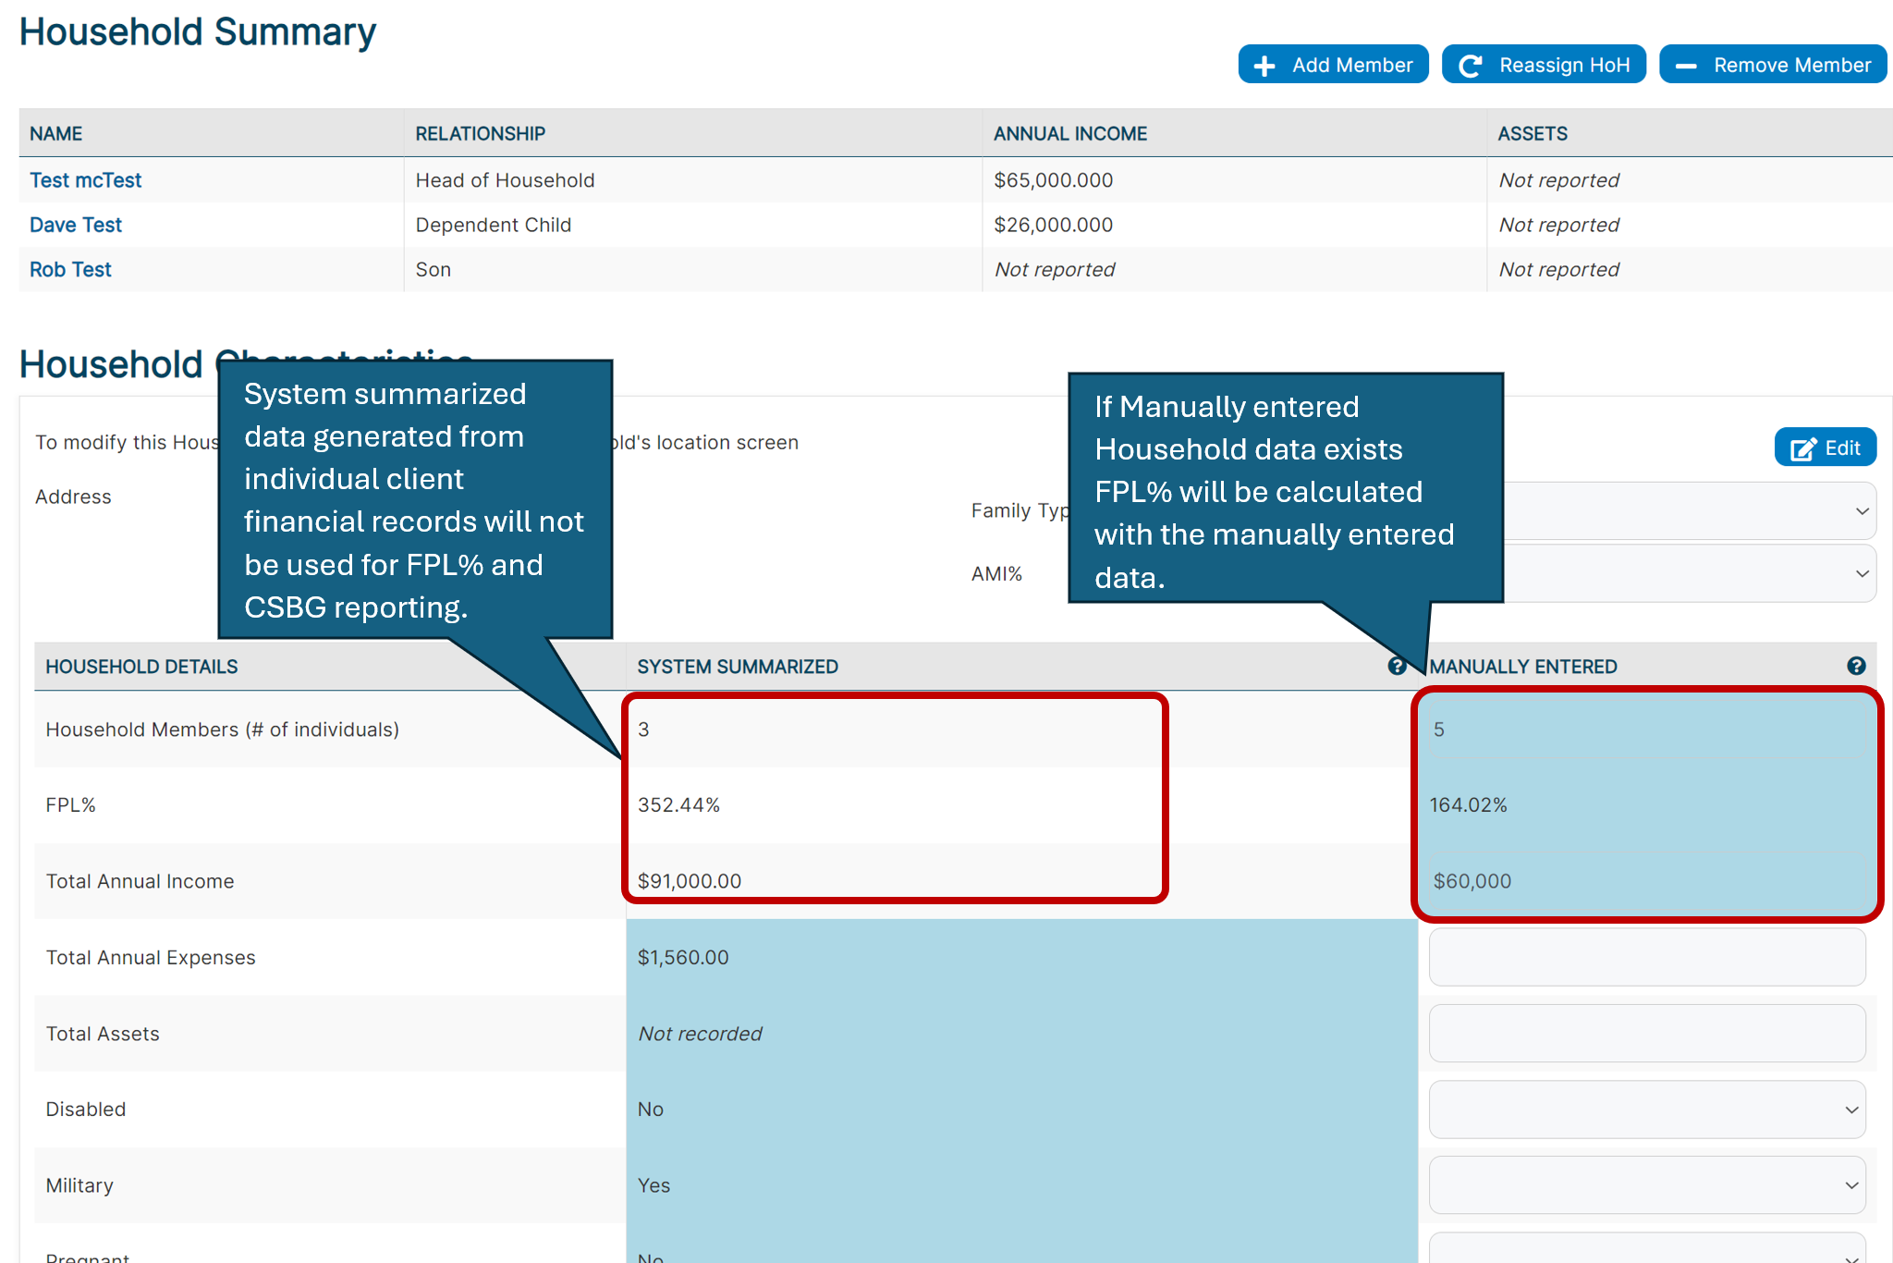
New Household Summary Screen

Slide 13
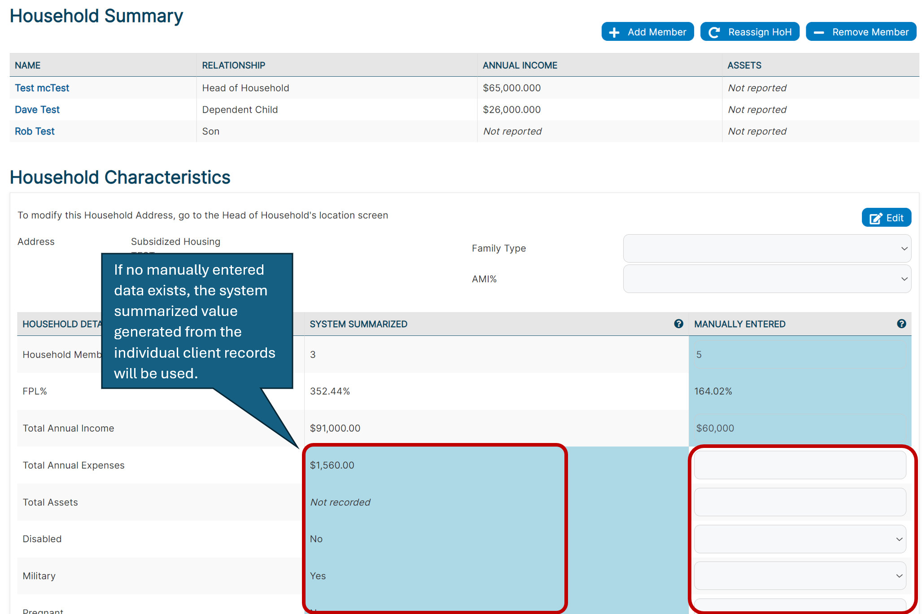
New Household Summary Screen

Slide 14
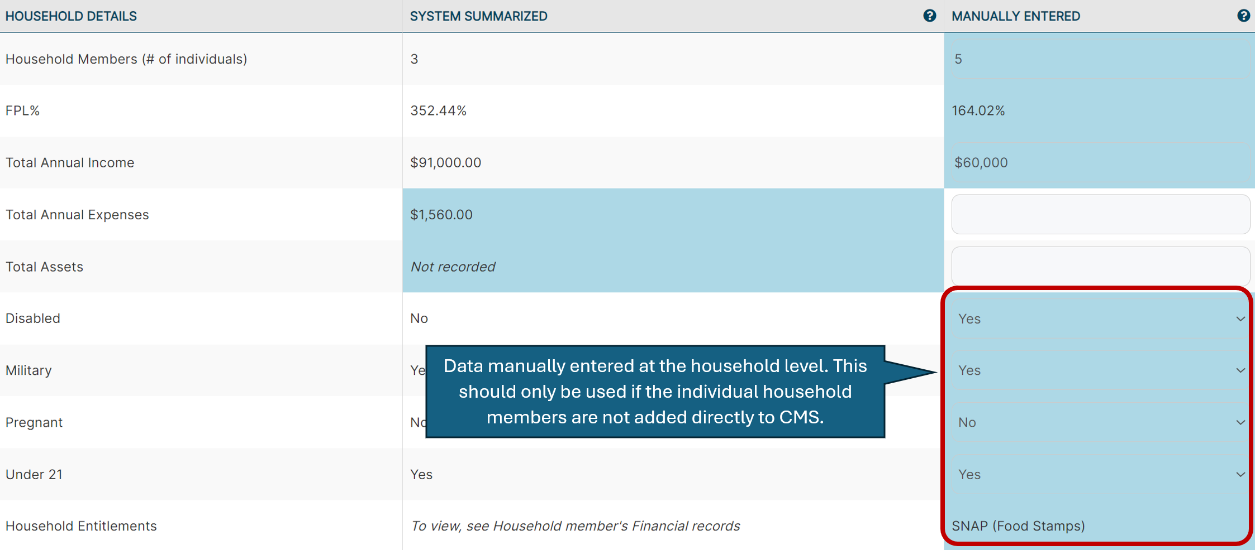
New Household Summary Screen

Slide 15
Household Intake– Key Points

Slide 16
Questions

