Slide 1
Case Notes & Shortcuts in CMS
MOC Inc

Slide 2
Agenda
Creating a Case Note
Client Notebook
Shortcut Buttons

Slide 3
Creating a Case Note

Slide 4
Creating a Case Note
Case notes for the client can be added from anywhere in the Client Record by clicking the Case Notes icon in the top right of the Client Record Header and clicking Add Client Note
In the New Note Screen the date will be defaulted to today but can be changed.
Select the Program the Case note is for
Enter the note in the text box
Tags can be used to organize case notes.
To add a tag to your case note, click the Select Tag(s) area of the screen to view the list of available tags. Click on the tag to add it to your case note.
Based on the tags that are associated with the note, you can filter client notes by tags within the Client Notebook.
The Private checkbox will make the note only visible to users of the Program specified in the note
Check the Alert box to make your case note an alert. By doing this, the case note will appear as an alert within the Client Notebook and appear with a red flag next to the name of the note.
By checking the "Private" box the Case note will only be visible to Users of the Program the Case Note is associated with

Slide 6
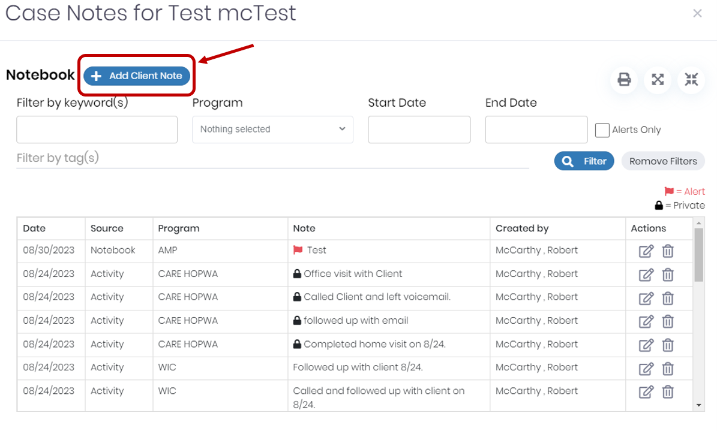

Slide 7
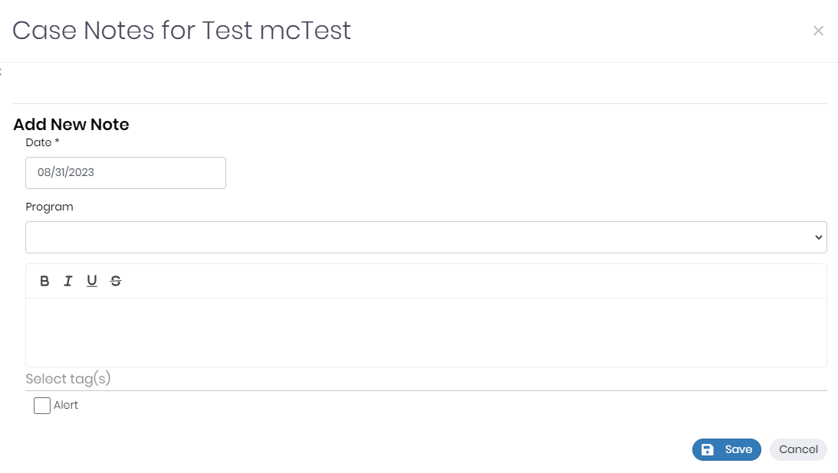

Slide 8
Client Notebook

Slide 9
Client Notebook
The Client notebook displays a list of all Case Notes for the client and their source
The list can be filtered by:
Keyword
Start Date
End Date
Alerts Only
To filter the Notebook, select the desired filters and click the Filter button. The table on the screen will filter accordingly.
To edit a note:
Click on the Edit button under the Actions column
The note selected will appear at the bottom of the notebook
Make any desired changes
Click save
Notebook Buttons:
Print - Clicking the Print button will generate a printable version of the filtered case notes.
Expand - Clicking expands all notes so each note record can be viewed in its entirety. Please note that you can click on an individual row to expand that row.
Collapse - Clicking collapses all note records so they return to only being one line tall. Please note that you can click on an individual row to collapse that row.

Slide 10
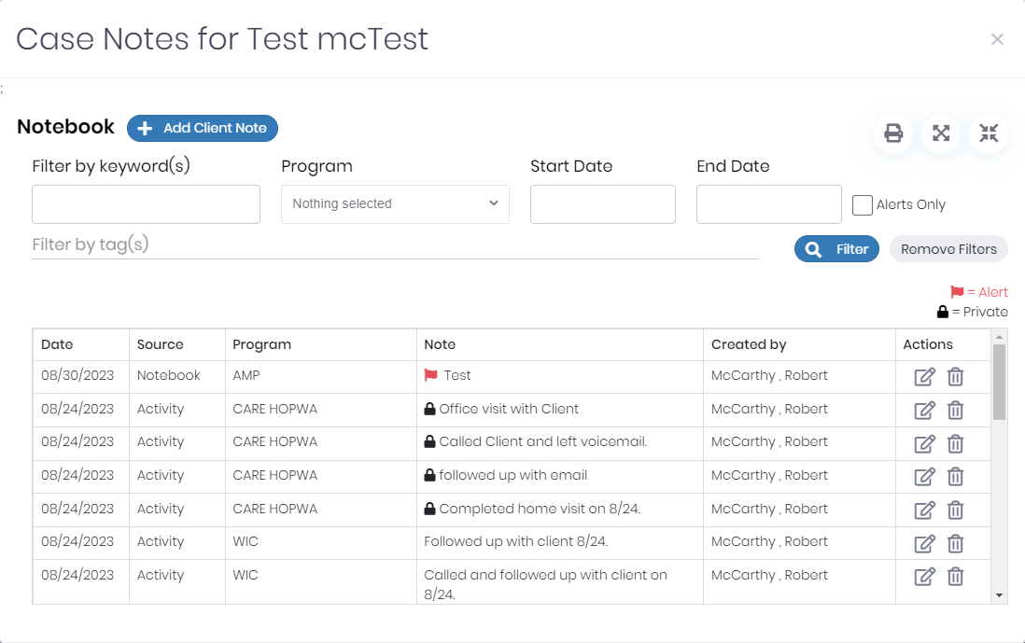

Slide 11
Shortcut Buttons

Slide 12
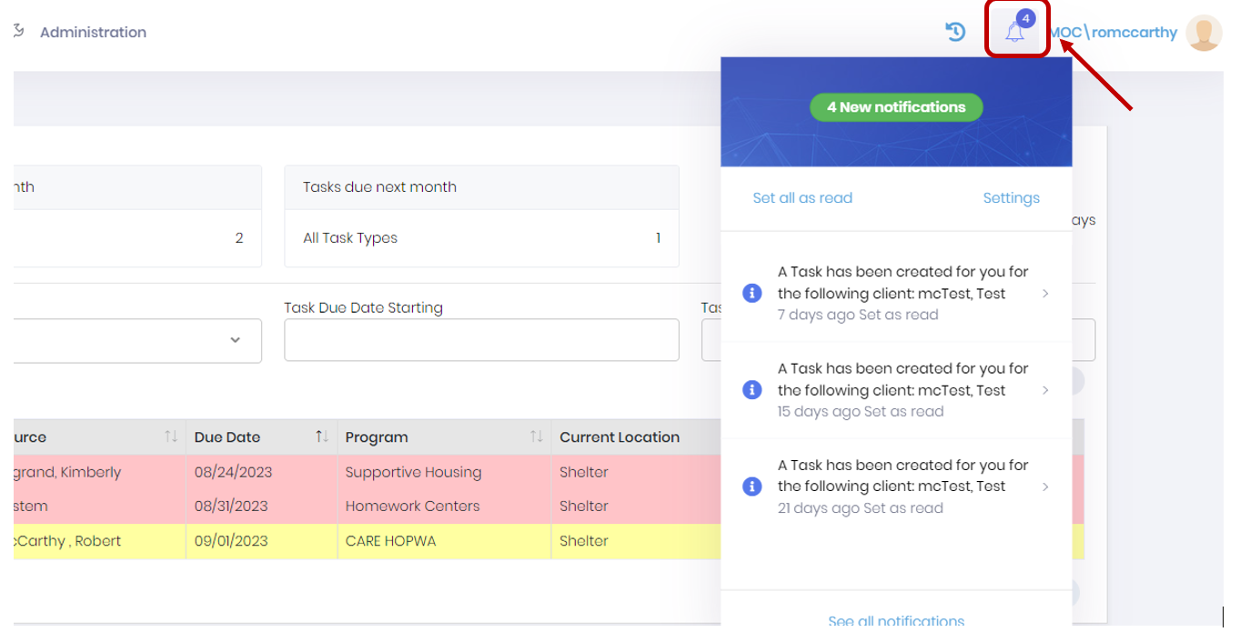
Alerts (Notification Bell)
In the System Navigation Toolbar, there is a bell icon that indicates how many alerts you have.
Clicking on an alert will bring you directly to the record of the client who is associated with the alert.
You can click the “See all notifications” button to navigate to the Notifications screen.

Slide 13
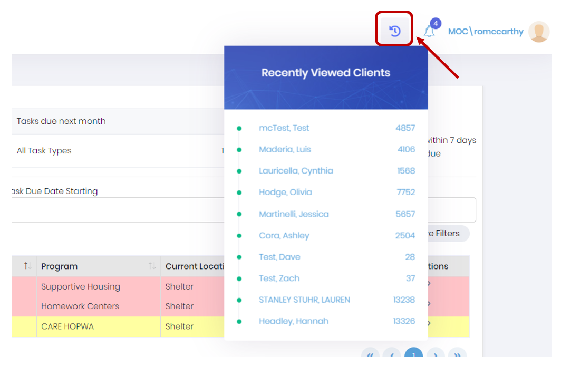
Recently Viewed Clients
To the left of the Notifications bell is a circular arrow icon used to track your recently viewed clients
This is useful to quickly get to Client Records which you have used recently or go to often
You can select any client from this dropdown to be linked directly to their client record

Slide 14
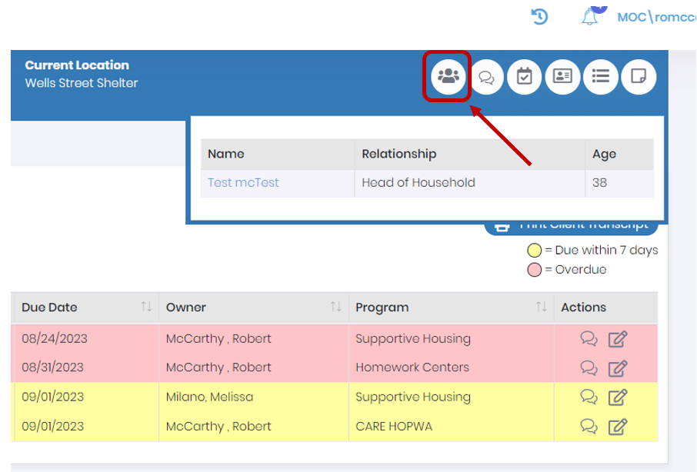
Household Summary
In the client record you can click on the Household Summary Icon in the far left on the Client Record Header
This can be used to easily see a summary of the clients in the household and easily navigate to the other clients record who are in the household

Slide 15
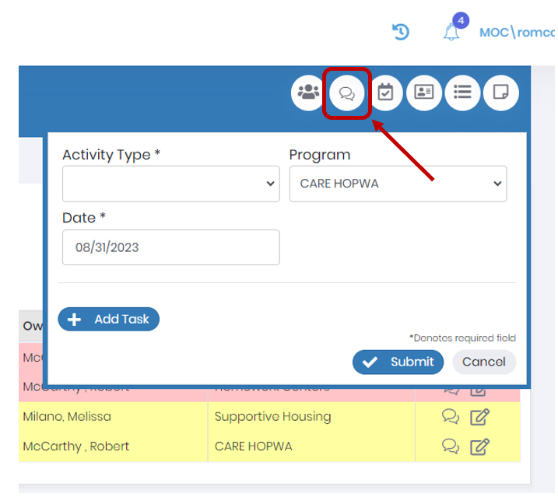
Log Activity
The Log Activity shortcut is used to log an activity such as a phone call with the client

Slide 16
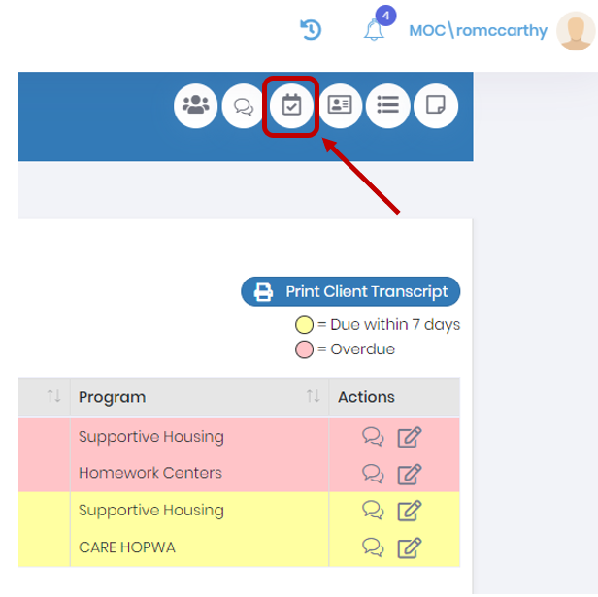
Schedule a Task
To the right of the log activity shortcut is the Schedule a Task button which can be used to create tasks

Slide 17
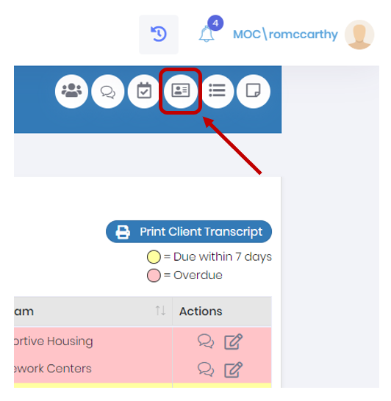
Phonebook
The phonebook shortcut will display the client's contact information as well as all of the contacts associated with the client such as a landlord or mental health care provider

Slide 18
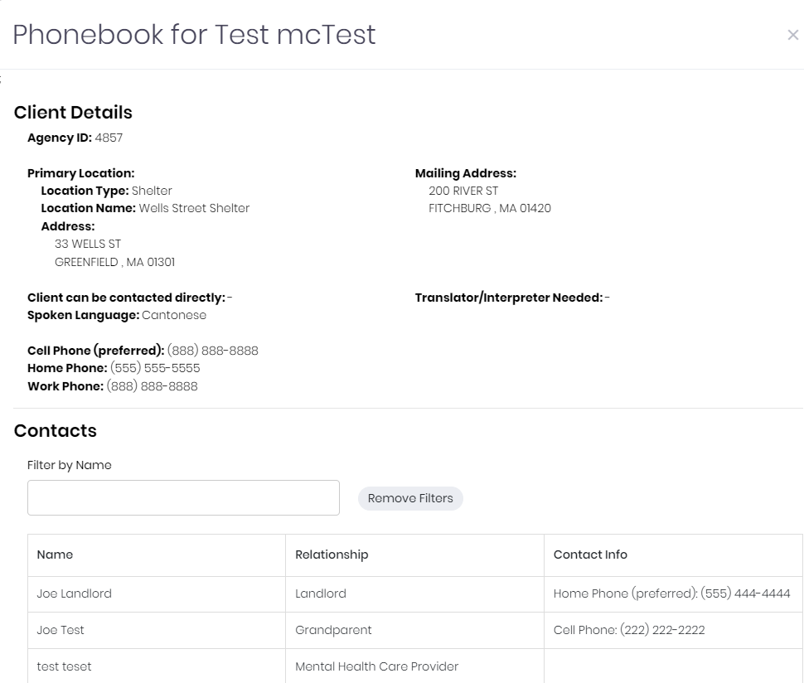
Phonebook

Slide 19
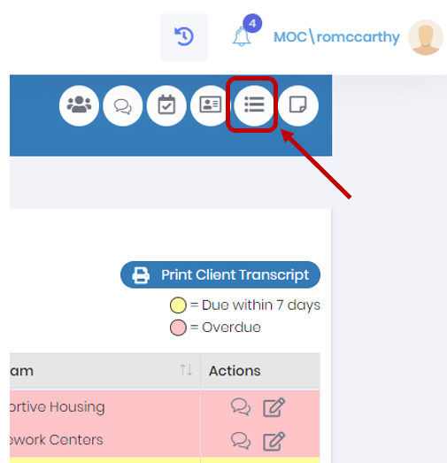
Focus Areas
Focus Areas shows domains in which the client could use attention determined by the evaluations completed for the client

Slide 20
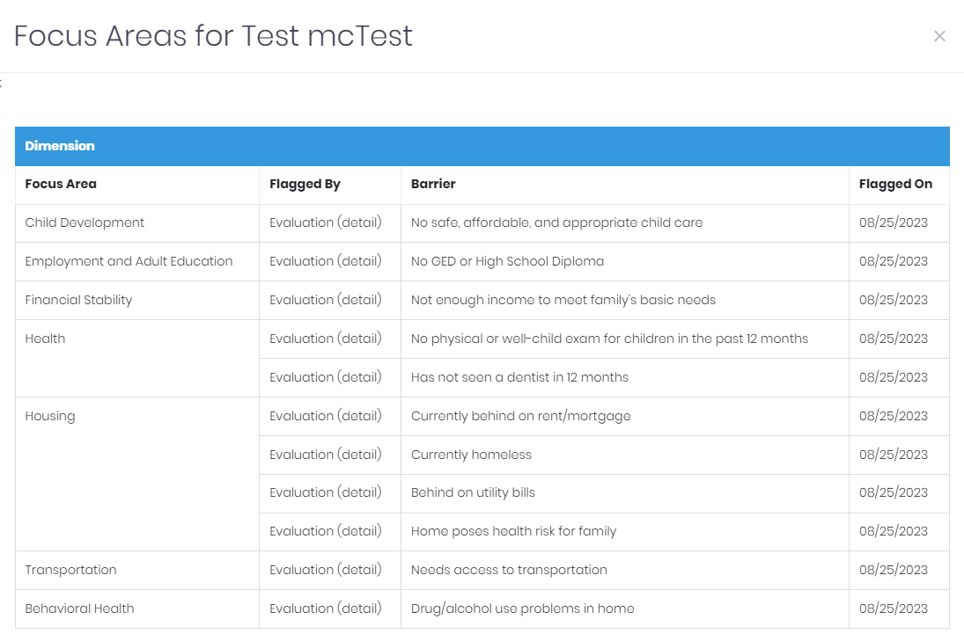
Focus Areas

Slide 21
Case Notes
Case notes for the client can be added by clicking the Case Notes icon and clicking Add New Note

Slide 22
Questions

