Slide 1
Reports

Slide 2
Agenda
Intro to V2 of the CMS Staff Operations Report
Key Benefits of Using the Report

Slide 3
Navigating to Reports Module

Slide 4
Reports Module
Log into CMS
Click on “Reports” in the Dashboard Header
Select the desired Report from the dropdown menu
In the top right of the report module is help documentation which gives a description of each report.

Slide 5
Client Detail Report

Slide 6
Client Detail
A detailed output of clients who have a program or referral. Clients viewed are limited by the permission of the user running the report. These permissions include specific client-based security and the programs assigned to the user.

Slide 7
Report Parameters
Primary Case Manager
Program
Program Variant
Start Date (Program)
End Date (Program)
Age Range Start
Age Range End

Slide 8
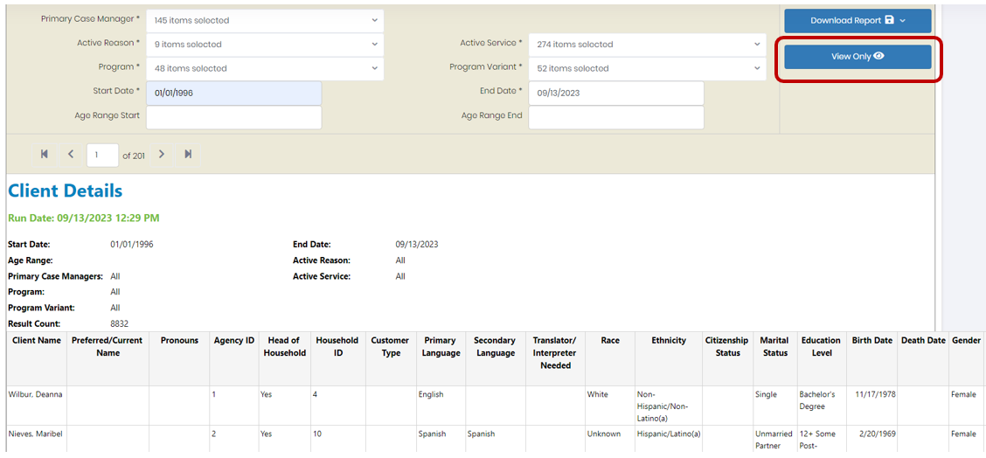
Client Detail
To view the results without downloading them click “View Only”

Slide 9
Client Detail
To download the reports for further filtering/Analysis click “Download Report” → “Excel”

Slide 10
Client Detail
highlight the first row of data and click Data -> Filter
Highlight the first row of data and click View → Freeze Panes → Freeze Top Row Only

Slide 11
Program Summary Report

Slide 12
Program Summary Report
An output of the clients that have an active program enrollment, program referral or both within the reporting time. Clients viewed are limited by the permission of the user running the report, these permissions include specific client-based security and the programs assigned to the user.

Slide 13
Report Parameters
Program or Referral
Program
Program Owner
Start Date
End Date

Slide 14
Client Service Delivery Report

Slide 15
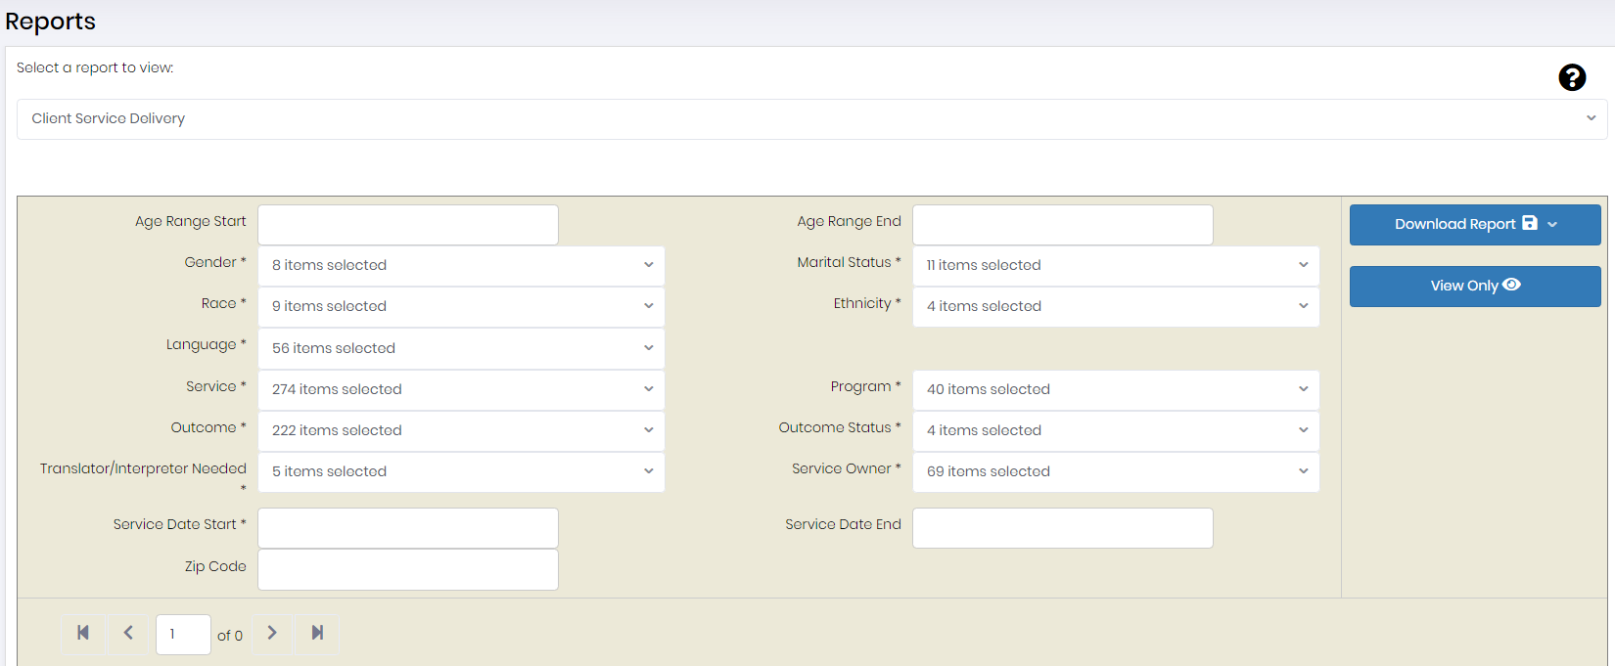
Client Service Delivery Report
A detailed output of client services within the reporting time period and their associated target/actual outcomes and completion dates. This report also includes the staff member and program responsible for providing each intervention to the client.

Slide 16
Report Parameters
Age Range Start
Age Range End
Gender
Marital Status
Race
Ethnicity
Language
Service
Program
Outcome
Outcome Status
Translator/Interpreter Needed
Service Owner
Service Start Date
Service End Date
Zip Code

Slide 17
Client Service Outcomes Report

Slide 18
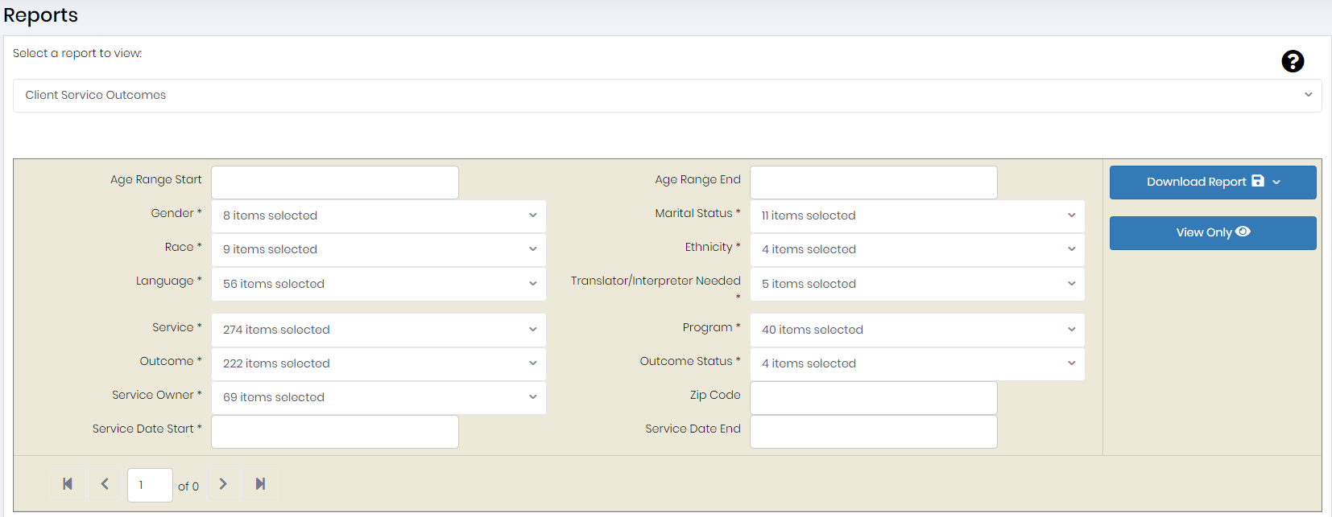
Client Service Outcomes Report
A detailed output of client services and their associated outcomes within the reporting time period. For each service and outcome, the report includes applicable statuses, target/actual completion dates, and the staff member and program responsible for providing each intervention to the client.

Slide 19
Report Parameters
Age Range Start
Age Range End
Gender
Marital Status
Race
Ethnicity
Language
Service
Program
Outcome
Outcome Status
Translator/Interpreter Needed
Service Owner
Service Start Date
Service End Date
Zip Code

Slide 20
Task Detail Report

Slide 21
Task Detail Report
A detailed output of client tasks. Tasks viewed are limited by the permission of the user running the report, these permissions include specific client-based security and the programs assigned to the user.

Slide 22
Report Parameters
Task Type
Task Program
Task Owner
Due Date Start
Due Date End
Completion Date Start
Completion Date End
* When downloading the results from the Task Detail Report results must be downloaded in .Csv format

Slide 23
Activity Detail Report

Slide 24
Activity Detail Report
A detailed output of activities. Clients viewed are limited by the permission of the user running the report. These permissions include specific client-based security and the programs assigned to the user.

Slide 25
Report Parameters
Activity Program
Activity Owner
Activity Start Date
Activity End Date
Activity Created On Start
Activity Created on End
* When downloading the results from the Task Detail Report results must be downloaded in .Csv format

Slide 26
Activity Detail Report

Slide 27
Activity Detail Case Notes Report
A detailed output of activities. Clients viewed are limited by the permission of the user running the report. These permissions include specific client-based security and the programs assigned to the user.

Slide 28
Report Parameters
Activity Program
Activity Owner
Activity Start Date
Activity End Date
Activity Created On Start
Activity Created On End
* When downloading the results from the Activity Detail Case Notes Report results must be downloaded in .Csv format in order to properly filter and sort by date.

Slide 29
Questions

