Slide 1
Goals in CMS
MOC Inc

Slide 2
Agenda
Introduction to the Goals Module
Goals Table
How to Create a Client Goal
How to Edit a Client Goal
How to add an Action Step
How to Edit an Action Step
How to Add and View Progress Notes
How to Print Out a Goals Report

Slide 3
Introduction to the Goals Module

Slide 4
Introduction to the Goals Module
The Goals Module is a feature of CMS that helps you track and manage the goals of your clients.
You can create, edit, and delete goals for each client, as well as add action steps and progress notes to monitor their progress.
You can also print out a comprehensive report of the client’s goals, including the goal details, action steps, and progress notes

Slide 6
Goals Table

Slide 7
Goals Table
The Goals table helps you track and manage the goals of your clients.
You can create, edit, and delete goals for each client, as well as add action steps and progress notes to monitor their progress.
You can choose to print out all client goals using the Print button from the top of the screen, or you can print out a single goal (including all details) using the print icon within a specific row of the Goals table.
The Goals table contains the following columns:
Goal Name: The name of the goal, such as “Achieve Employment.”
Goal Type: The type of goal, such as mental health, employment, or housing.
Program: The program that the goal is associated with.
Owner: The CMS user that created the Goal or the user who is assigned the Goal.
Start Date: The date when the goal was created.
Target Achieve Date: The date when the goal is expected to be achieved.
Goal Status: The current status of the goal, such as “In Progress” or “Completed.”
Status Date: The date the Goal Status was most recently changed.

Slide 9
Creating a Client Goal

Slide 10
How to Create a Client Goal
To create a new goal, go to the Goals screen
Click the “+Add New Goal” button at the top of the screen.
Fill in the required fields, such as goal type, goal name, program, owner, start date, and target achieve date.
You can also add optional fields, such as goal statement, strengths, preferences, motivations and outcomes.
Click Save.

Slide 12
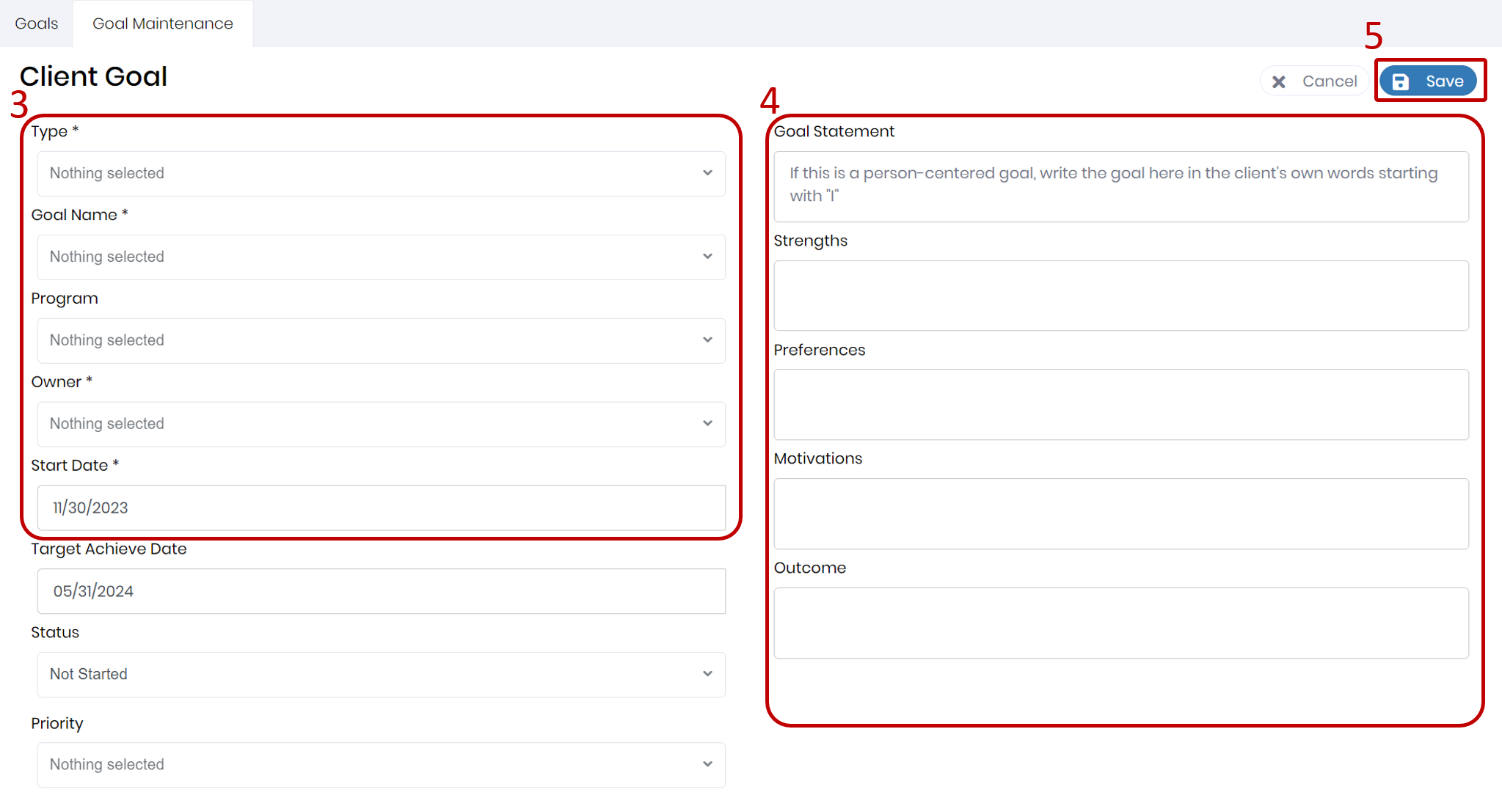

Slide 13
Editing a Client Goal

Slide 14
How to Edit a Client Goal
To edit an existing goal, go to the Goals screen.
Click the Details icon within the row of the goal you want to modify under the Actions column.
Click the Edit button on the Goal Maintenance screen to make changes to the goal details.
You can also delete an existing goal from this screen by clicking the Delete button.
Click Save.

Slide 16
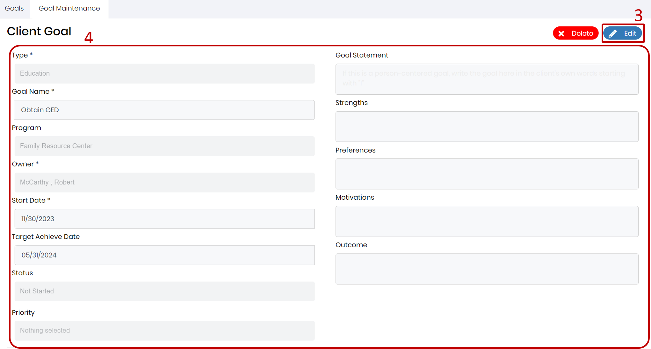

Slide 17
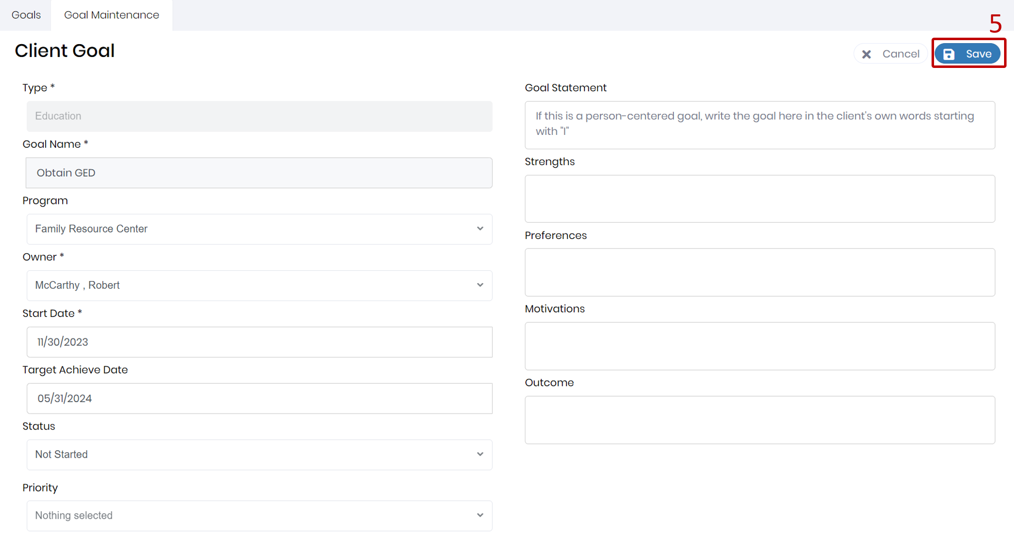

Slide 18
Adding an Action Step

Slide 19
Adding an Action Step
Action steps are specific tasks that the client needs to complete to achieve their goal.
To add a new action step:
Click the Details icon within the row of the goal you want to add Action Steps for
Click the “+Add New” button at the bottom of the Action Steps table.
Fill in the fields, such as action step name, start date, focus area, target achieve date, with whom, and status.
Please note the "With Whom" is the person responsible for completing the Action Step such as Client, parent, guardian, ect. And not the MOC staff who created the Goal.
Click Save

Slide 21
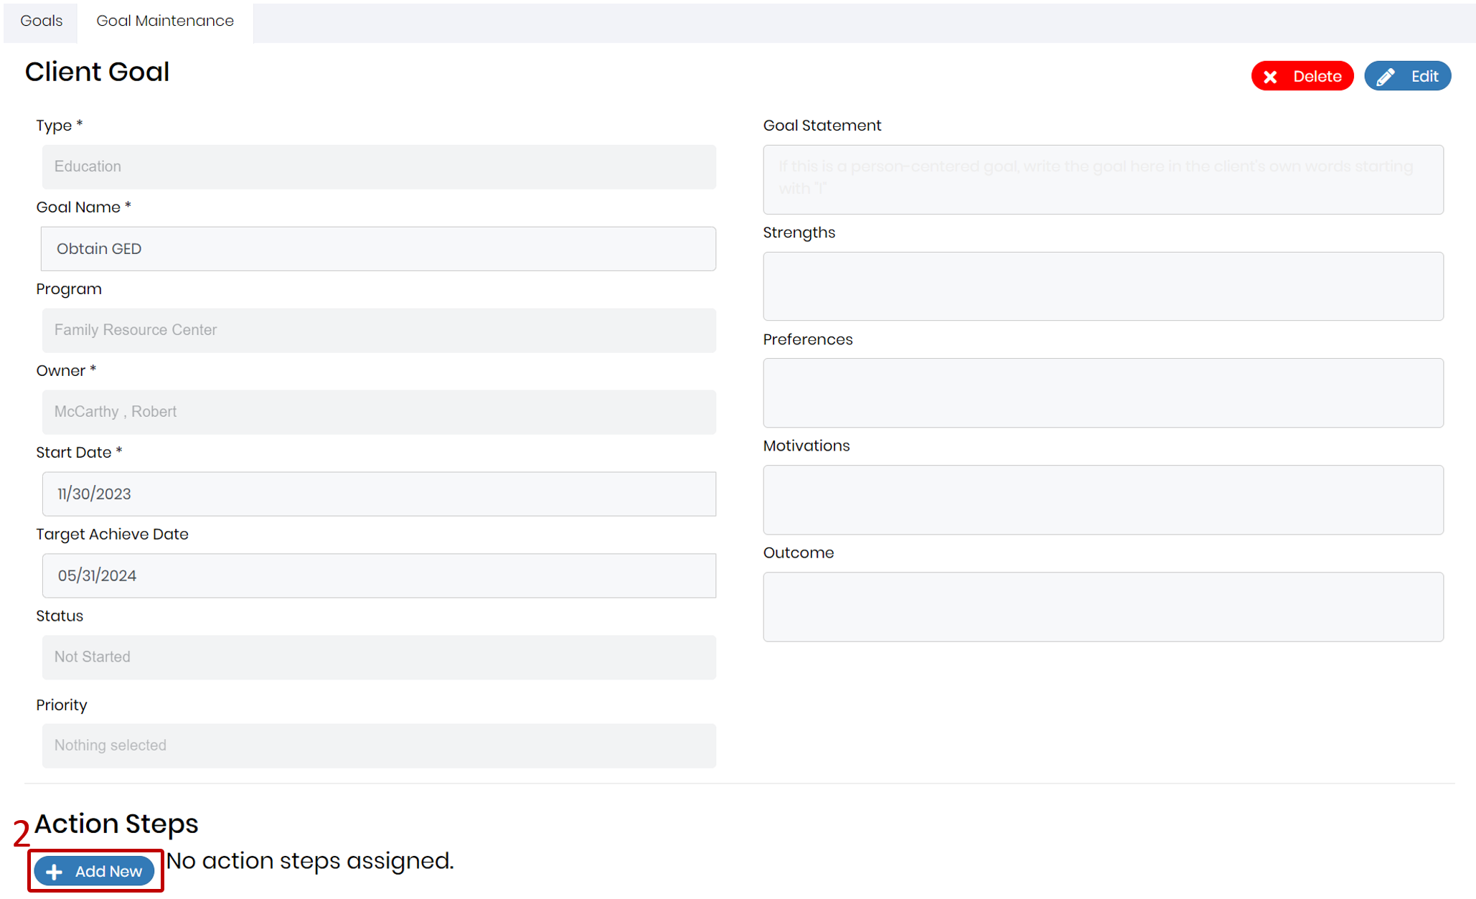

Slide 22
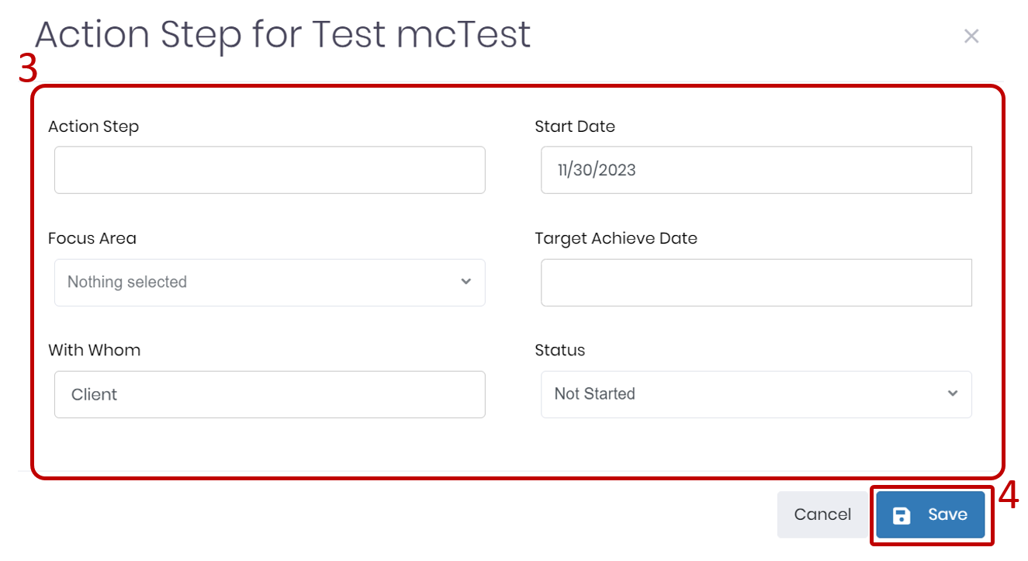

Slide 23
Editing an Action Step

Slide 24
How to Edit an Action Step
To edit an existing action step, go to the Goal Maintenance screen.
Click the Edit button within the row of the action step you want to modify.
Make necessary changes.
Click Save.
You can also delete an existing action step from this screen by clicking the Trash icon.
You can reorder the action steps by dragging and dropping the rows within the table.

Slide 26
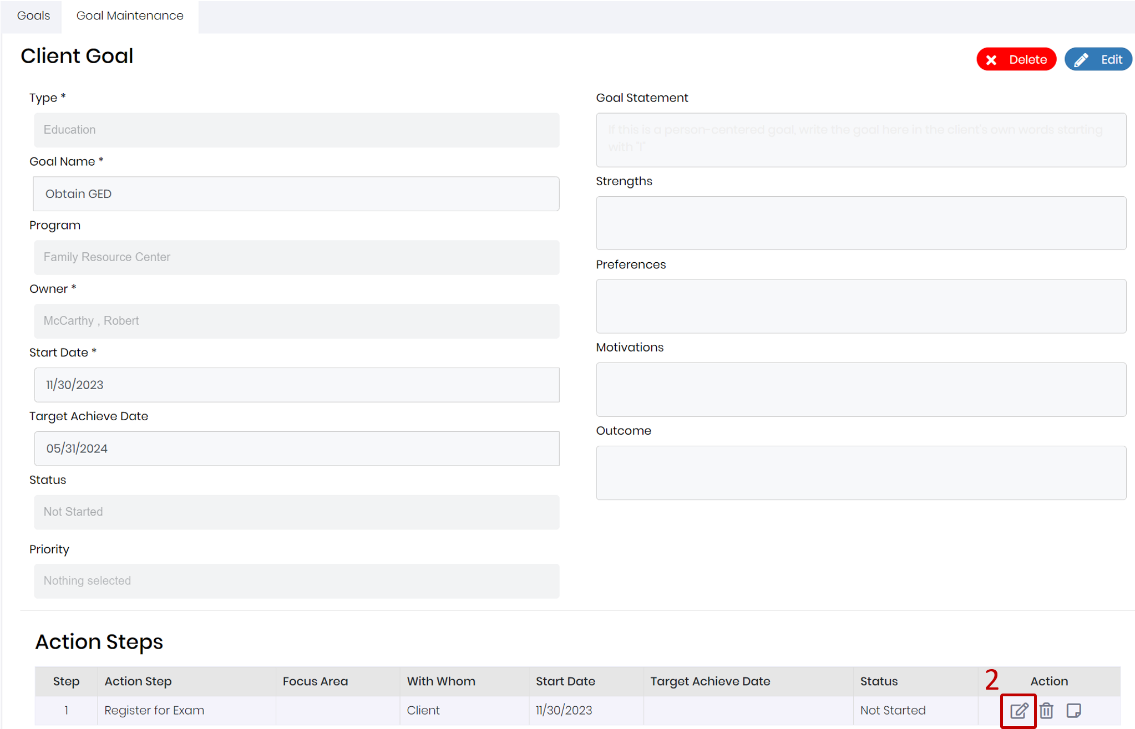

Slide 27
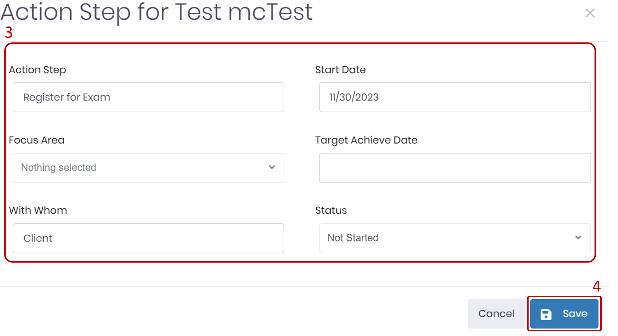

Slide 30
Adding and Viewing Progress Notes

Slide 31
How to Add and View Progress Notes
Progress notes are records of the client’s achievements, challenges, feedback related to their action steps, or any additional comments you would like to add.
To add a new progress note, go to the Goal Maintenance screen and click the Add Note icon under the Actions column within the row of the action step you want to comment on.
Fill in the required fields, such as note date, and note text.
The progress note will be automatically tagged with “Goal” and the focus area of the action step. You can use these tags to search for the note within the Client Notebook.
You can save the note in process or submit the note. If you save the note in process, you can edit the note later. If you submit the note, the note will be submitted to the Client Notebook and you can no longer edit the note.
To view the existing progress notes for an action step, go to the Goal Maintenance screen and click on the row of the action step you want to see. You will see a list of all the progress notes that have been logged for that action step.

Slide 32
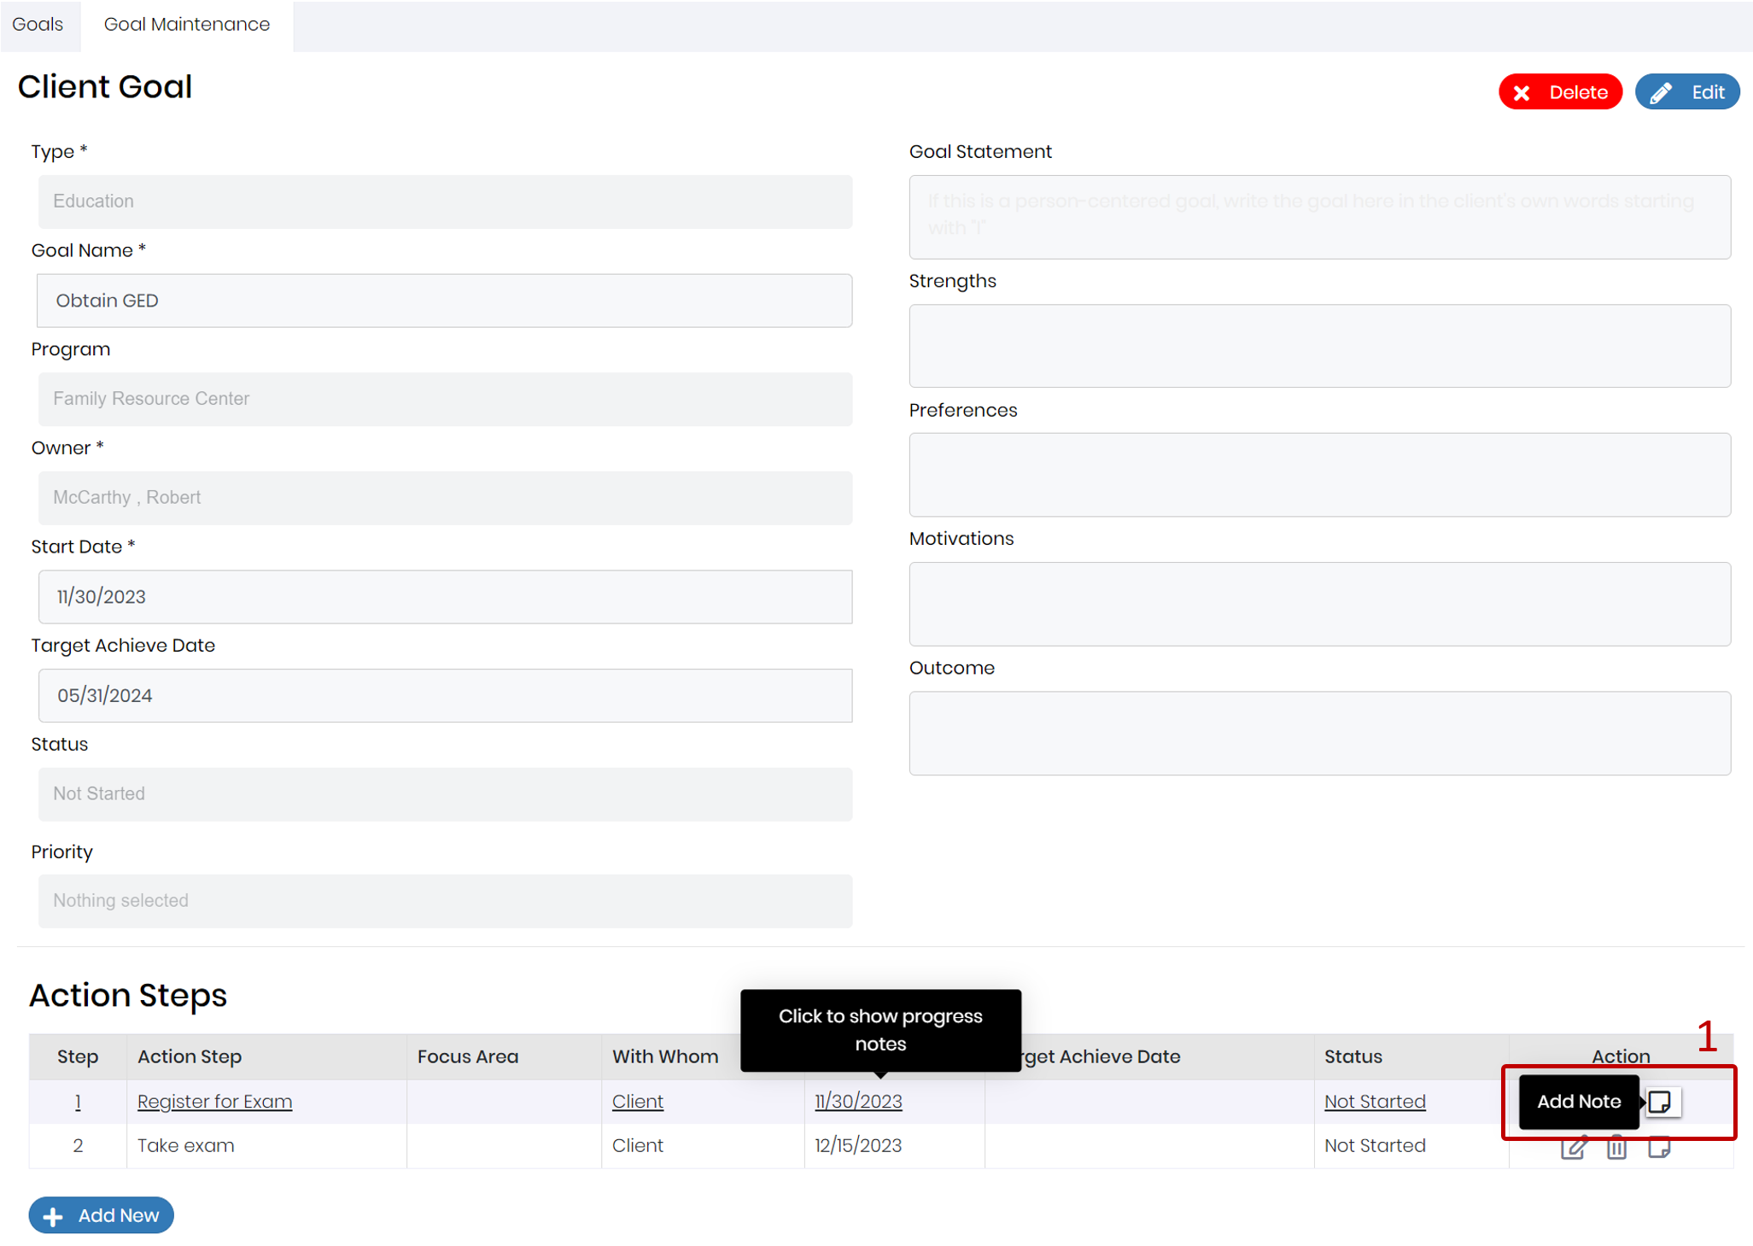

Slide 33
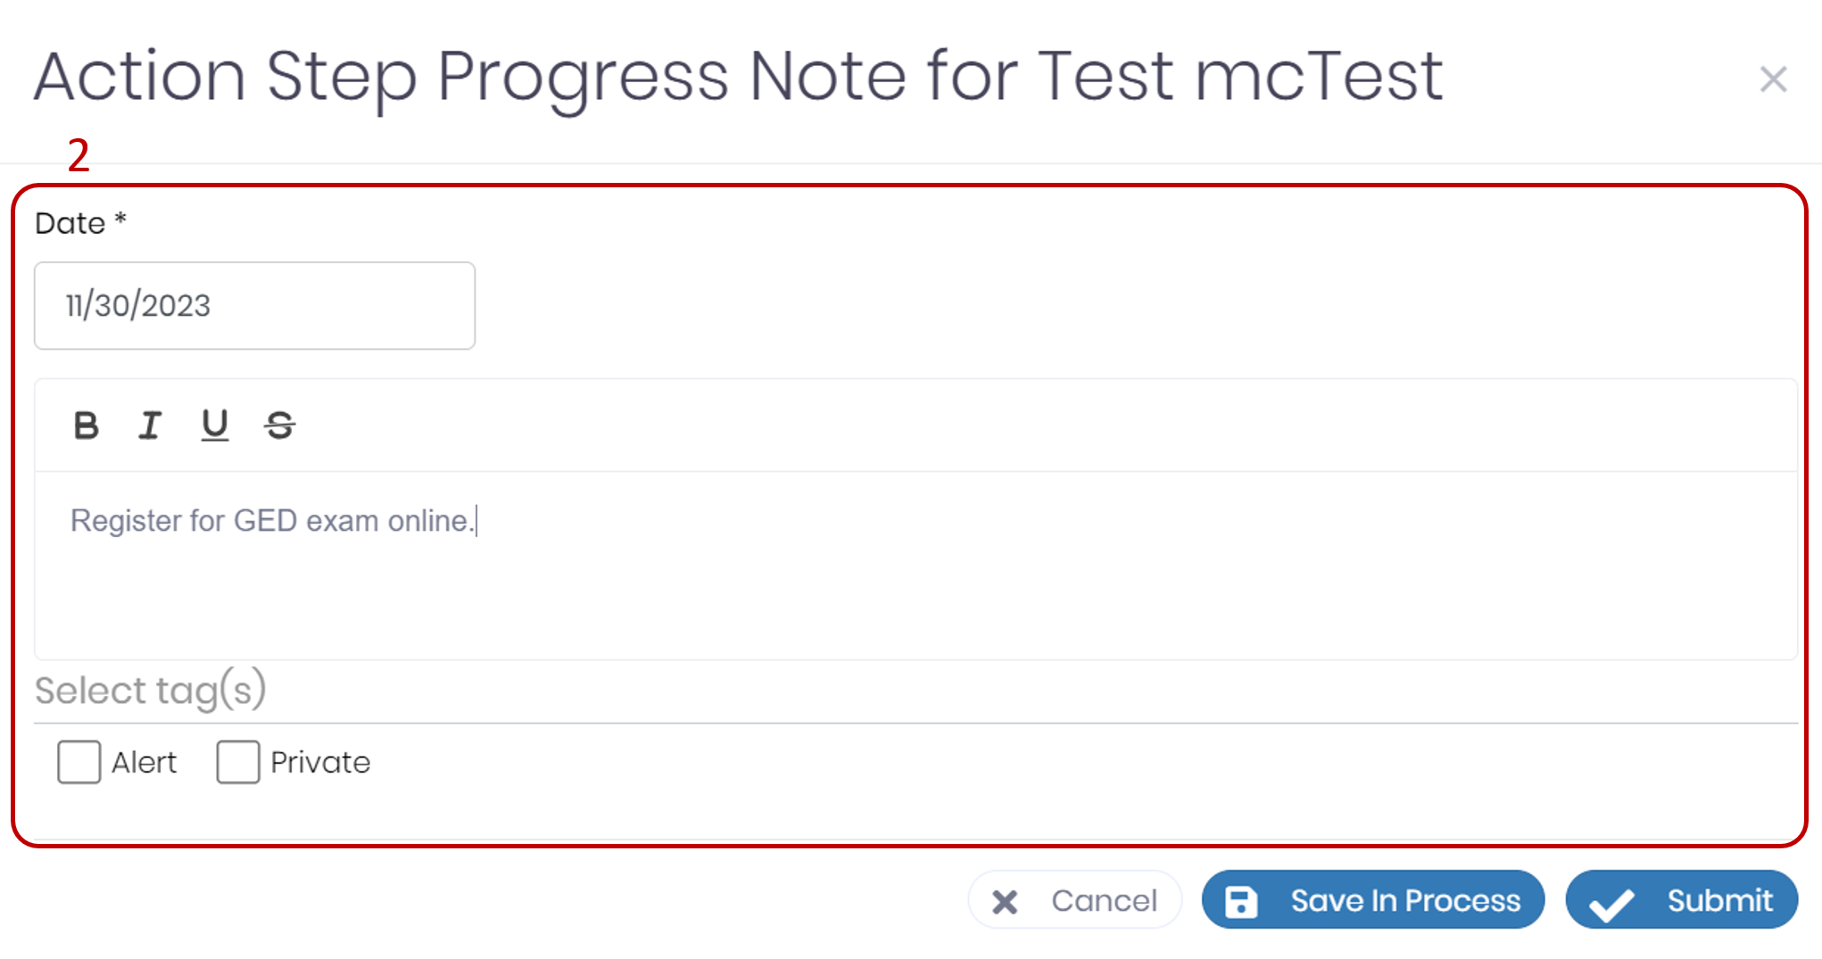

Slide 34
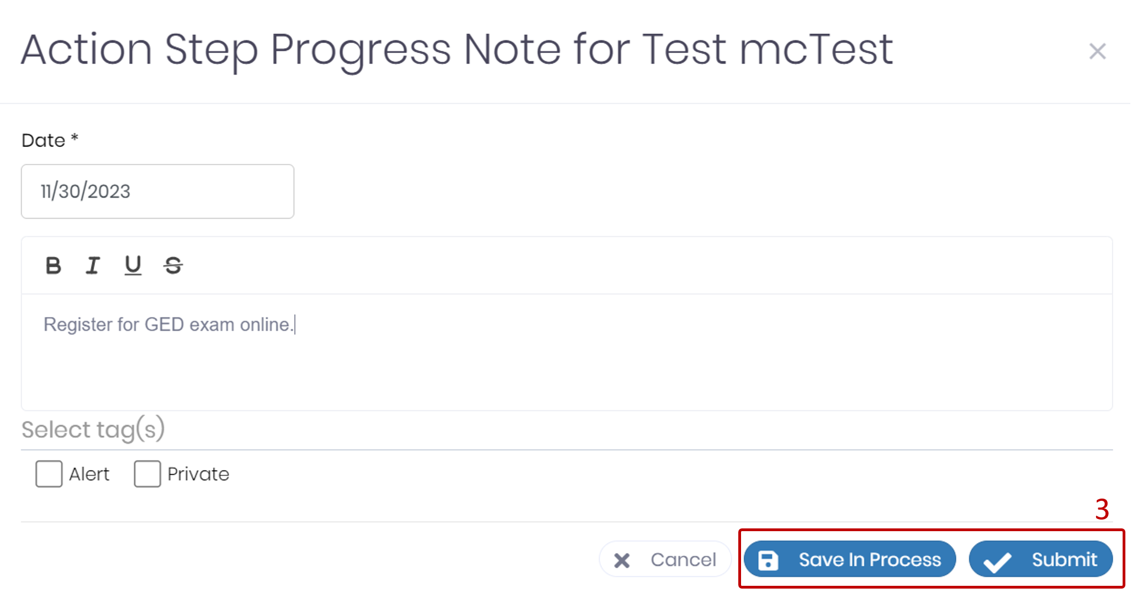

Slide 36
Printing the Goals Report

Slide 37
How to Print Out a Goals Report
To print out a report of all the client’s goals, go to the Goals screen and click the “Print” button at the top of the screen
You will see a printable output that includes the following information for each goal:
Client name and ID
Current Date
Goal type and name
Start date and target achieve date
Program
Goal description
Strengths, preferences, and motivation
Goal status
You can also print out a single goal by clicking the Print icon within the row of the goal you want to print.

Slide 39
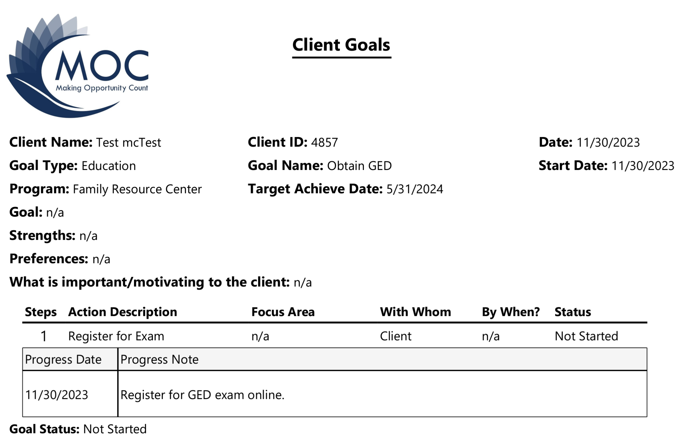

Slide 40
Questions

